Slide 1
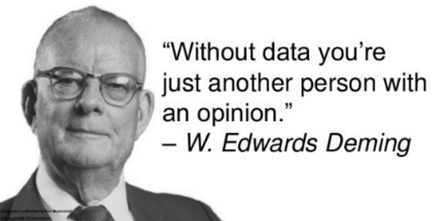
Probability and
Data analysis
STAT 2332

Slide 2
First week checklist
Read the syllabus and get familiar with D2L.
Register for the textbook and homework site (ALEKS).
Download R and R Studio (free).
Review prerequisite math skills.
Complete “Ch.0 Homework”
(which covers the syllabus and our math skills review).

Slide 3
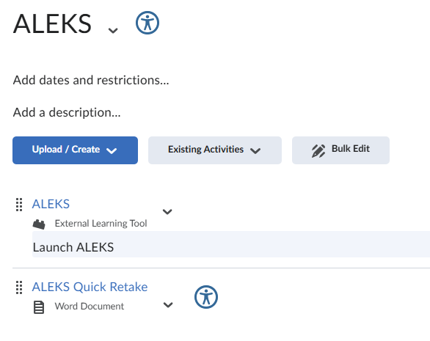
How to get to aleks
In D2L, go to Content, then Getting Started,
then ALEKS, and then click the top link
that looks like a puzzle piece and says,
“Launch ALEKS.”

Slide 4


r and r studio are two separate downloads
Link to download R
Link to download R Studio

Slide 5
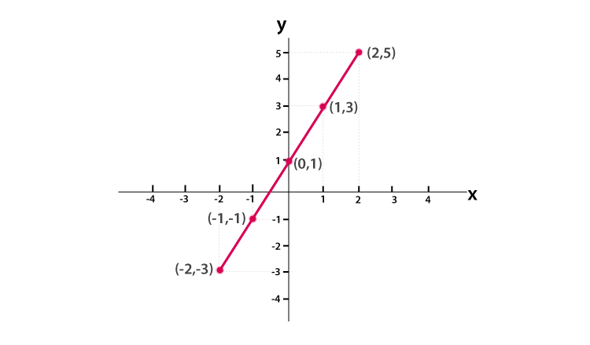
Prerequisite math skills
Rounding
Fractions, decimals, and percentages
Reading a number line
Order of operations
Simple linear graphs
Roots, exponents, factorials
Scientific notation
Integrals (review later)

Slide 6
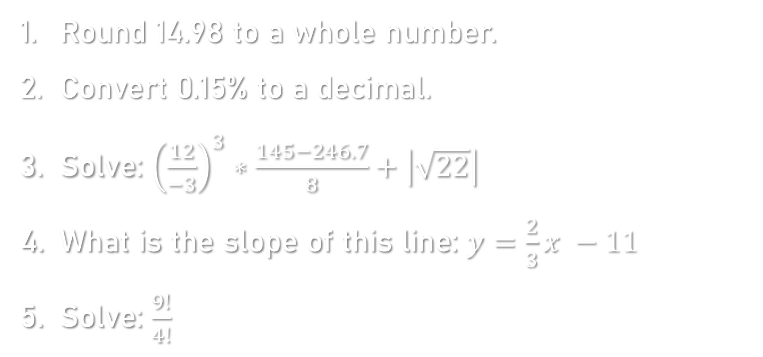
Practice #1-5
Round 14.98 to a whole number.
Convert 0.15% to a decimal.
Solve: ${\left(\frac{12}{−3}\right)}^{3}∗\frac{145−246.7}{8}+\left|\sqrt{22}\right|$
What is the slope of this line: $y=\frac{2}{3}x −11$
Solve: $\frac{9!}{4!}$

Slide 7
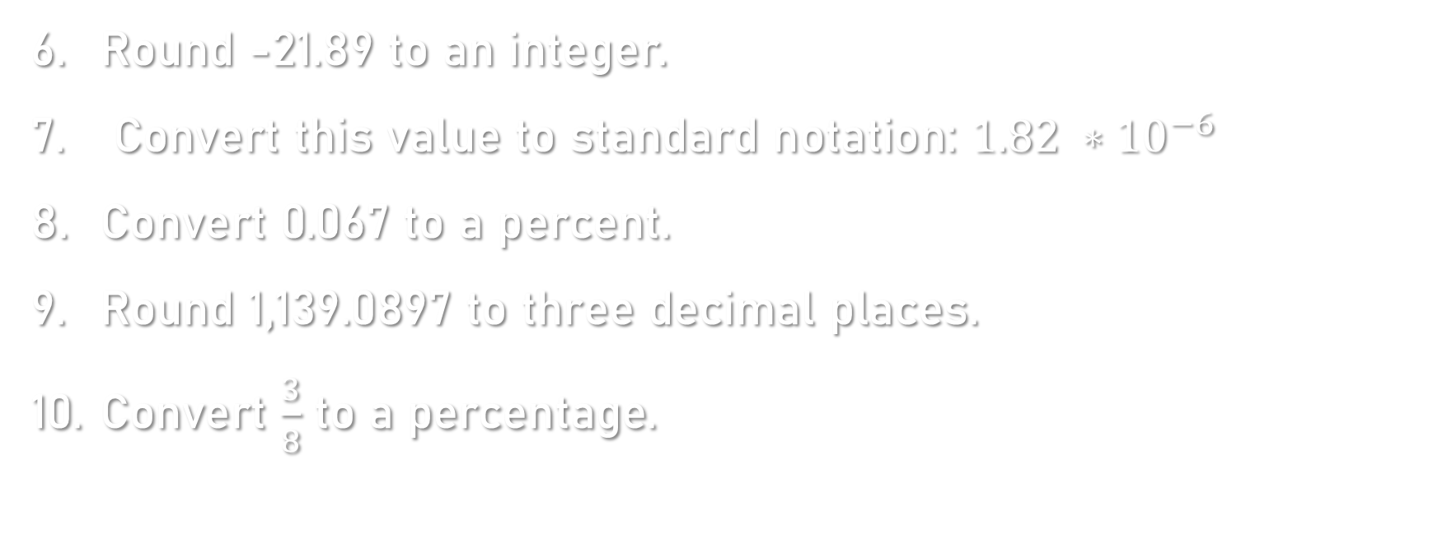
Practice #6-10
Round -21.89 to an integer.
Convert this value to standard notation: $1.82 ∗{10}^{−6}$
Convert 0.067 to a percent.
Round 1,139.0897 to three decimal places.
Convert $\frac{3}{8}$ to a percentage.

Slide 8
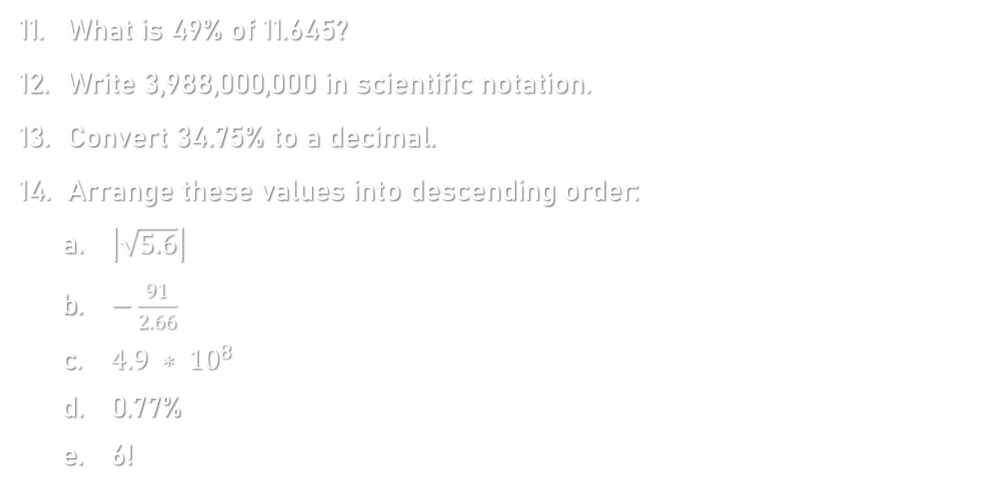
Practice #11-14
What is 49% of 11.645?
Write 3,988,000,000 in scientific notation.
Convert 34.75% to a decimal.
Arrange these values into descending order:
  $\left|\sqrt{5.6}\right|$
  $−\frac{91}{2.66}$
  $4.9 ∗ {10}^{8}$
  0.77%
  6!

Slide 9
Orientation to r studio:
Comments
### ORIENTATION TO R STUDIO ##########################
Text that follows a "#" symbol is a comment.
# Comments don't "do" anything.
# They are used for annotations.
# To run code, click on a line, or highlight multiple lines, and click "run.“
# You can also type ctrl + enter. # Remember: R is case-sensitive!!!
#----------------------------------------------------

Slide 10
Orientation to r studio:
Math operations
### Basic Math Operations
3 + 7 # addition
11 - 28 # subtraction
4 * 3 # multiplication
9 / -8 # division
3**2 # exponents
3^2
sqrt(77) # square root
8^(1/3) # cube root
factorial(4) # factorial = 4!
# order of operations: PEMDAS
3-7*88/-2
(3-7)*88/-2

Slide 11
Orientation to r studio: creating objects
### Creating Objects
# To create an object: object_name <- assigned_value
a <- 3 # numerical objects
print(a)
print(A)
A <- 5
a <- -7 # R will assume the last line you ran (check environment)
a + Aa - A2*a+7/A
color <- "yellow" # character/string objects
print(color)
color2 <- "green“
shape <- "square and circle“
zip <- "30062“
zip + 3

Slide 12
Orientation to r studio: creating vectors
# A vector is an object that contains a list of values.
my_numbers <- c(3, 5.55, -6, 12.0003) # numerical
print(my_numbers)
friends <- c("Matt", "Karen", "Foggy", "Claire") # character
print(friends)

Slide 13
Orientation to r studio: saving a script
### Saving a Script ##################################
# Always save your R Studio work in a script.
# Go to File - New File - R Script.
# Save a file for each assignment, for example "ch2hw.R".
# An R script is saved as a .R file.
# You can save and edit a script like a Word document.
# Type and run your code in the script,
# NOT directly in the console.

Slide 14
Orientation practice
#1. Save your script as "Orientation_Practice.R".
#2. Solve: ((4/3)^3 - 8.44 + sqrt(98))/-7
#3. Make an object called B and assign it a value of 33.978.
#4. Make an object called C and assign it a value of 7!.
#5. Solve: B + 2*C
#6. Make a vector called numbers that includes: your height in inches, your age, and the number of siblings you have. Print it in the console.
#7. Make a vector called family that includes the names of four family members. Print it in the console.

